Slide 1
G H Raisoni College of Engineering, Nagpur
Department of Computer Science Engineering
Progress Report on
6 Months major project
Session: 2018-19
Presented By:
Simran Gyanchandani
Vishitosh Kapale
Yash Nayak
Niraj Ranjan
Group No : C01
College Guide: Prof. Piyush Ingole

Slide 2
AirPrint
18.09.2018

Slide 3
Overview
Overview
Study Of Existing Solutions Vprint
Comparison
Components
Website
Workflow
Measurement
References

Slide 4
Project Progress Seminar-1

Slide 5
Architecture

Slide 6
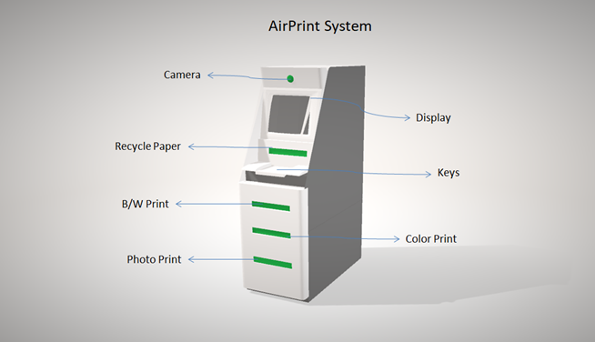

Slide 7
Study Of Existing Solutions:
Vprint
Existing system focuses on print jobs more efficiently but the problem that students are facing is due to blind multiple scanning. Jobs get printed at the specified Printer attached to it only. And sometime it leads to document lost. Student's or users are unable to know how much time to get our print job done? Specified printer print releasing makes and specified server print releasing methodology. At the print release station no effective utilization of the resources because of improper queue monitoring and lack of blind scanning it becomes very tedious and time consuming for students. As the VPRINT accounts crediting process is done manually only this consumes more time and efforts of students. Hence our project is an attempt to overcome such problems

Slide 8
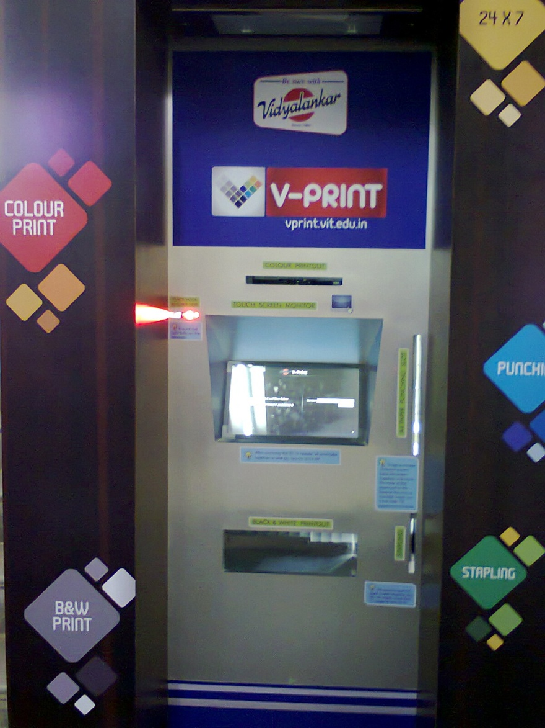

Slide 9
Comparison
Vprint | Airprint
Inconvenient | User Friendly
Inconvenient Screen Interface | Touch Screen Interface
No Internet Print Portal | Internet Print Portal
Only For A4 Size | All Type Of Printing
Non Scalable | Scalable
No Payment Methods | Payment Gateway
No Provision For Recycling | Provision For Recycling

Slide 10
Components

Slide 11
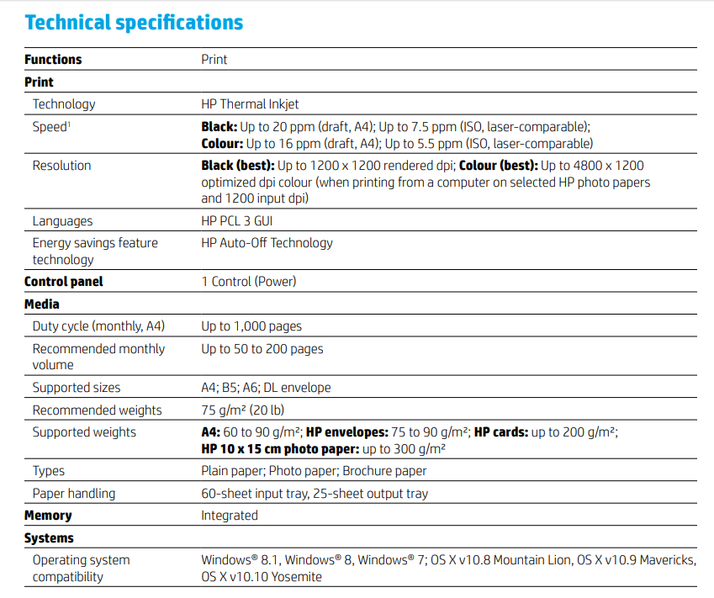
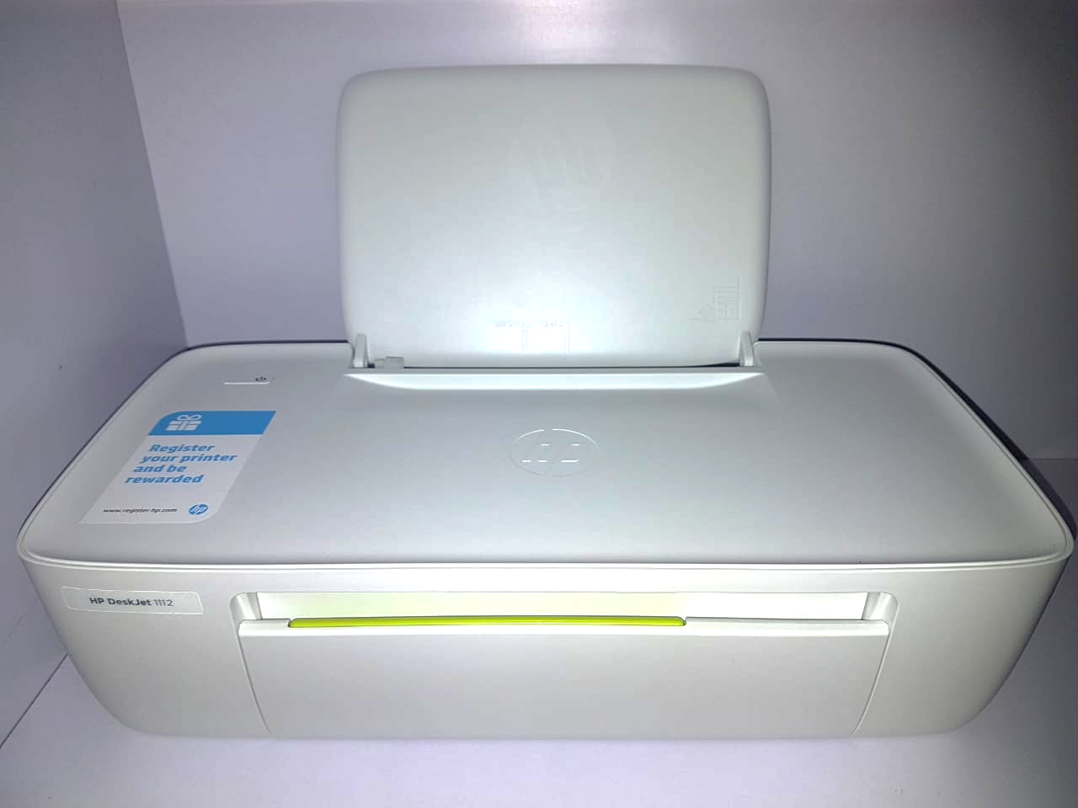
Printer

Slide 12
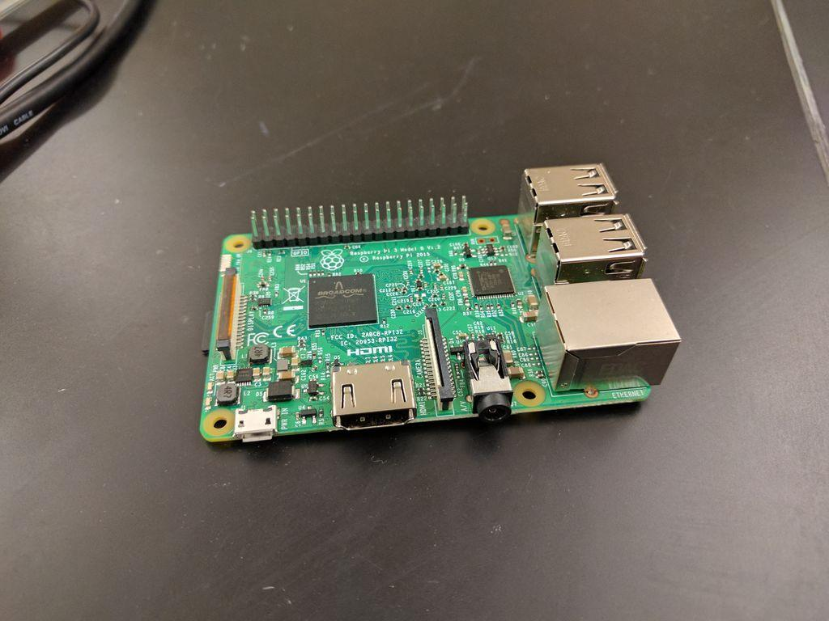
The Raspberry Pi 3 Model B+ maintains the same mechanical footprint as both the Raspberry Pi 2 Model B and the Raspberry Pi 3 Model B. Adafruit made/brand cases will still fit but some other cases may not, especially ones that depend on component location or have a built in a heatsink.
You can still use all your favorite Raspbian or PIXEL software with this update - just make sure to upgrade your Raspbian operating system install so that the firmware can support the new chips.
The dual-band wireless LAN comes with modular compliance certification, that's the metal tin in the corner of the Pi, with the logo stamped on it. This allows the board to be designed into end products with significantly reduced wireless LAN compliance testing, improving both cost and time to market.
Raspberry Pi 3

Slide 13
Website

Slide 14
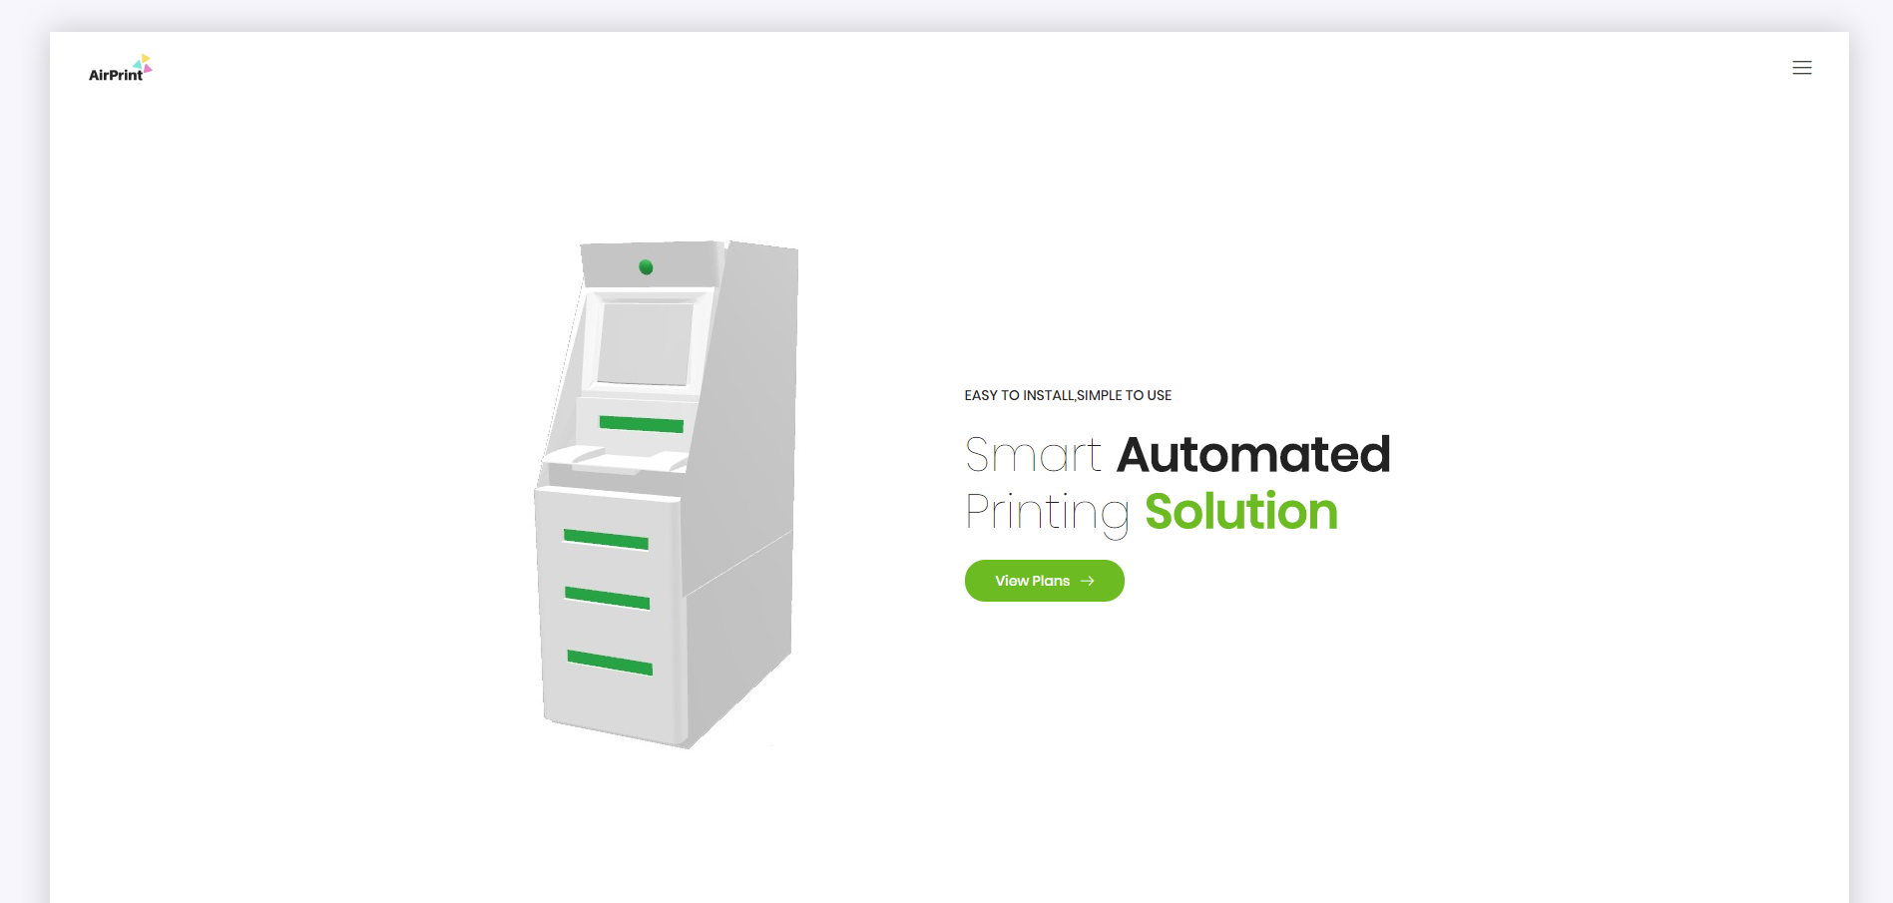

Slide 15
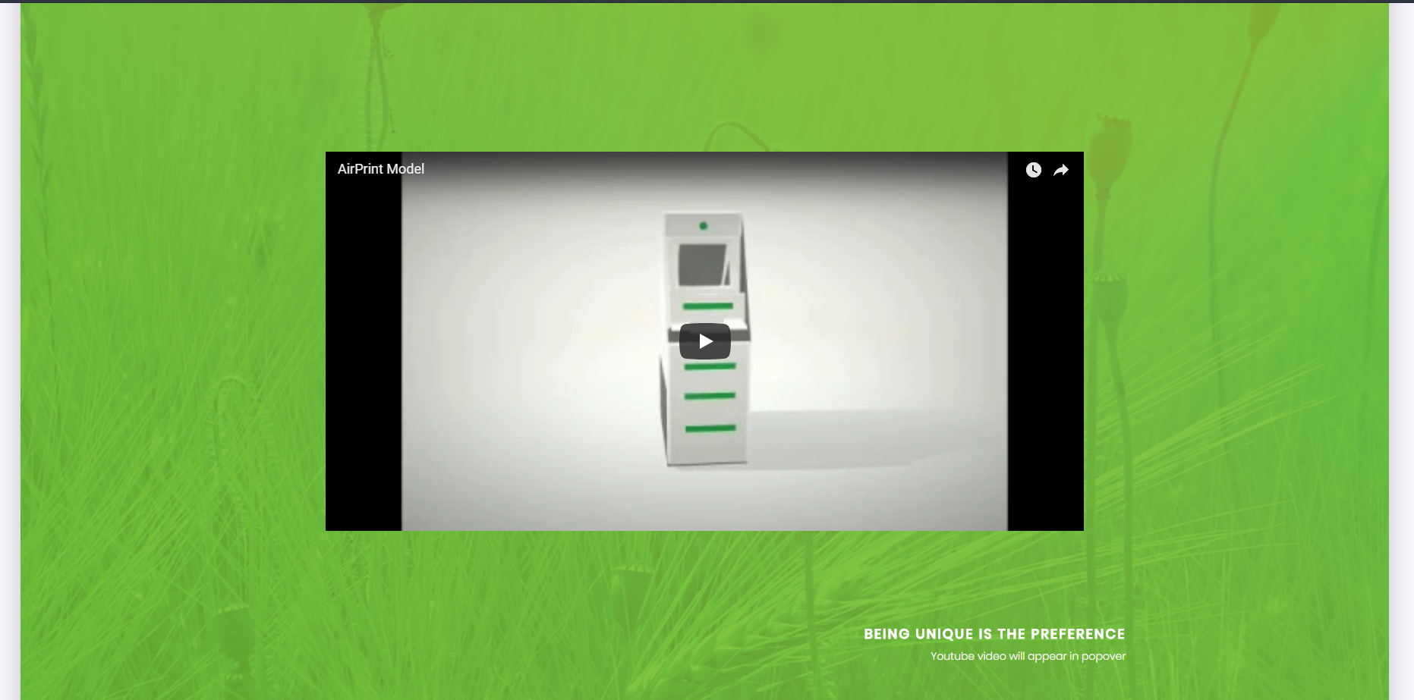
contd..

Slide 16

contd..

Slide 17
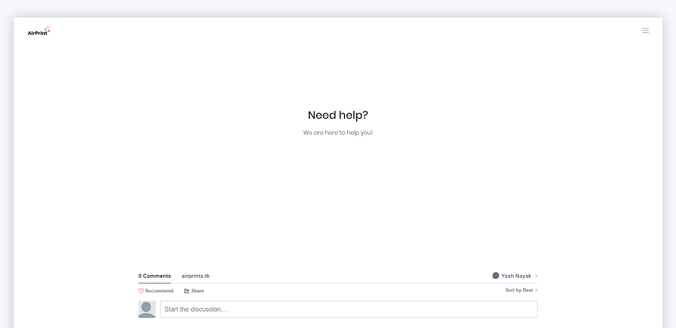
contd..

Slide 18
Workflow

Slide 19
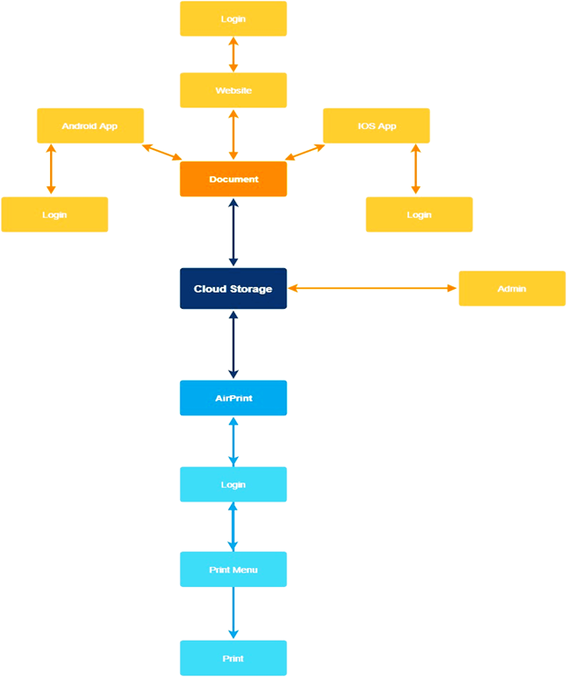

Slide 20
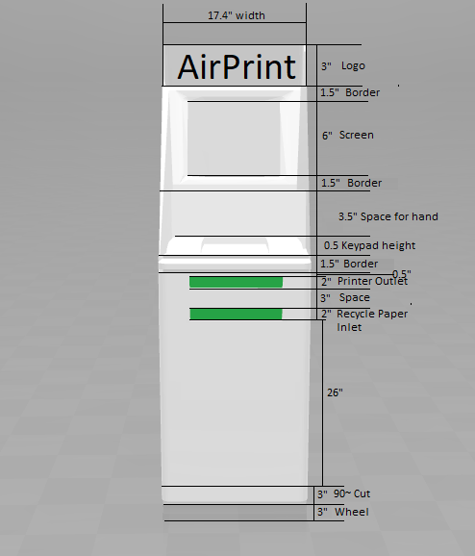
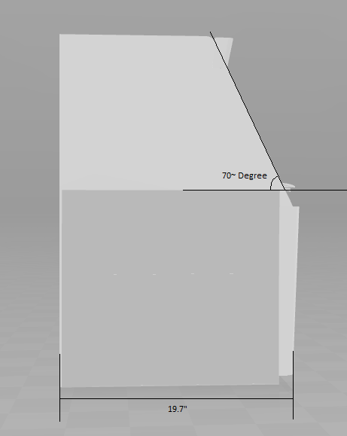
Measurement

Slide 21
Project Progress Seminar-2

Slide 22
WebApp

Slide 23


Slide 24
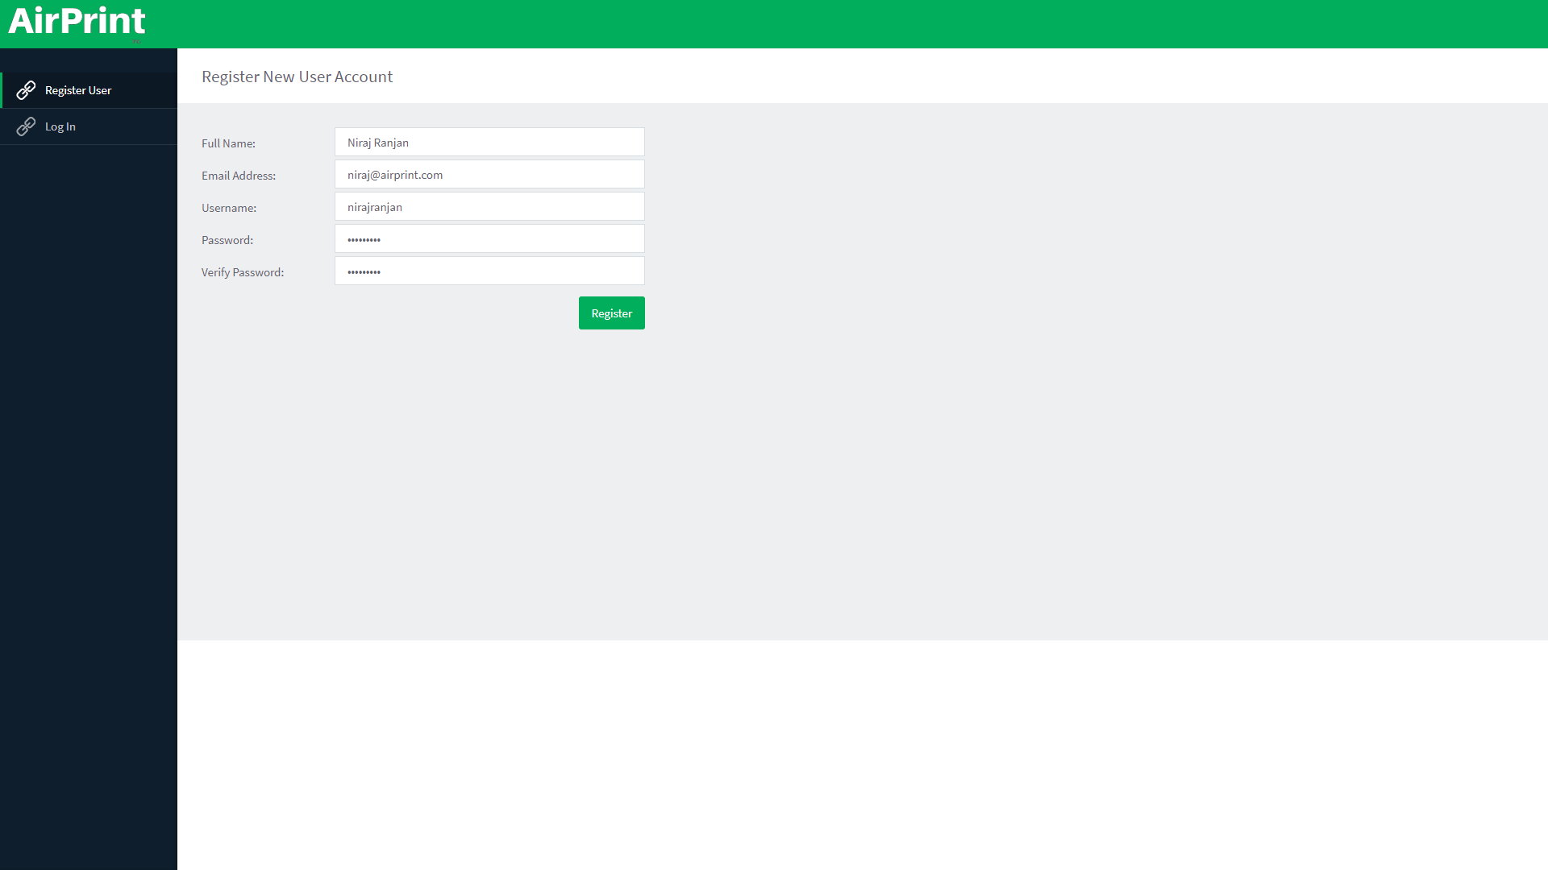

Slide 25


Slide 26


Slide 27
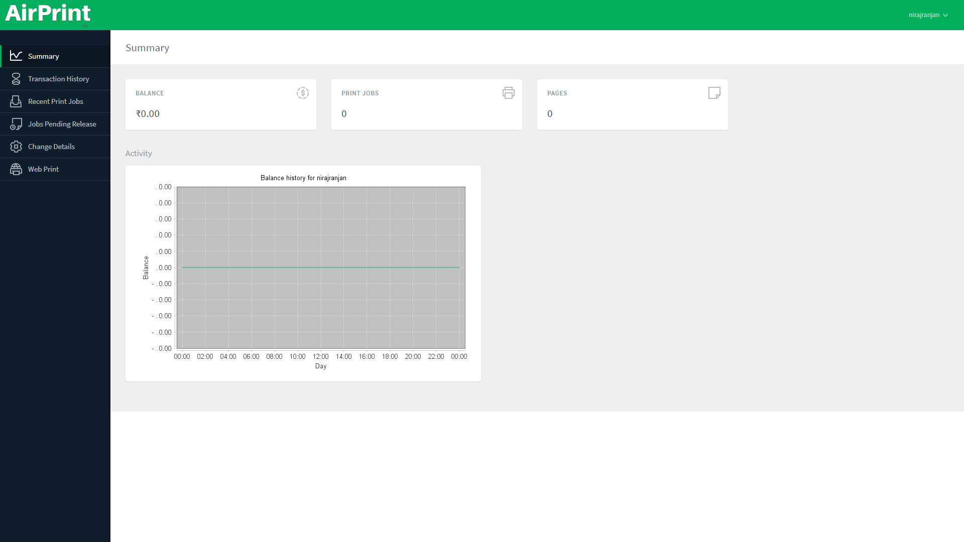

Slide 28
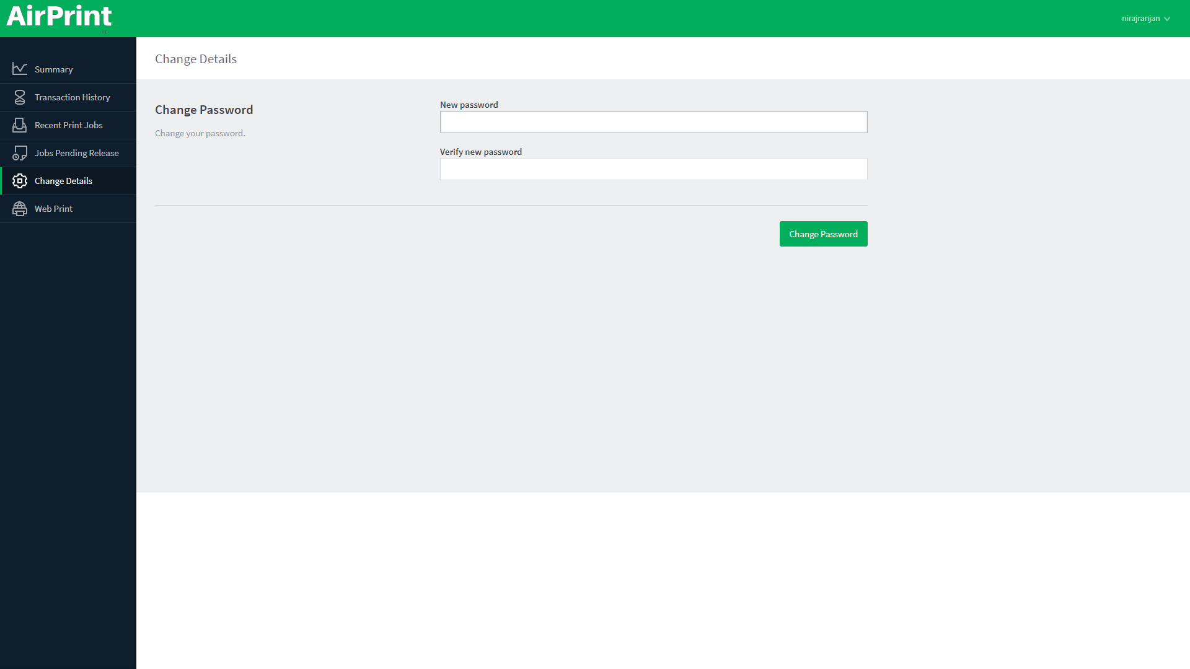

Slide 29
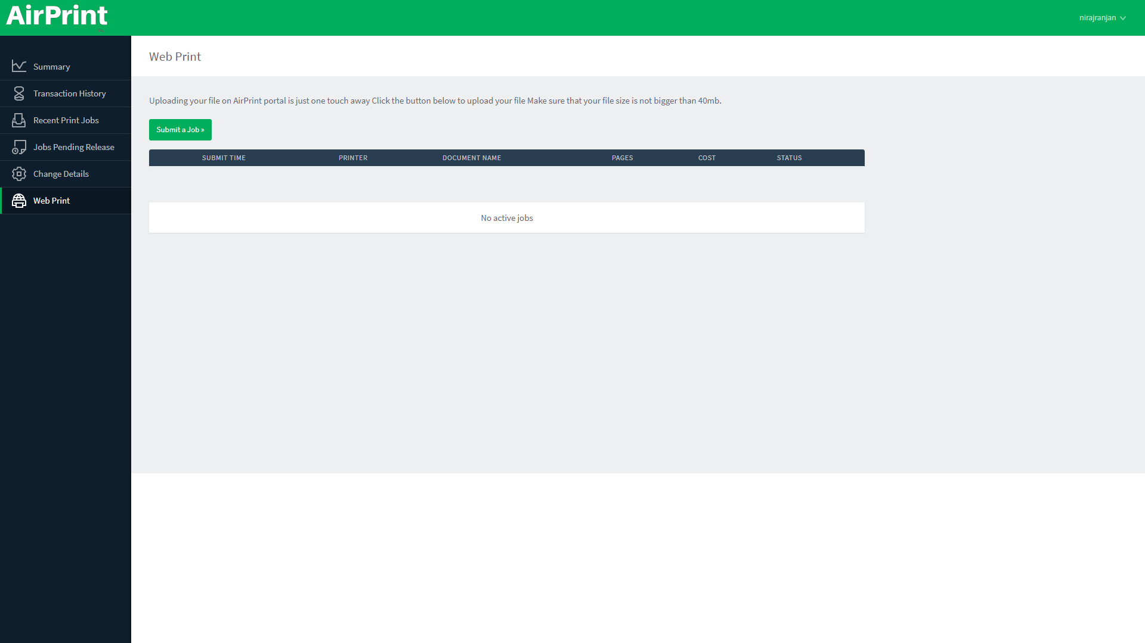

Slide 30
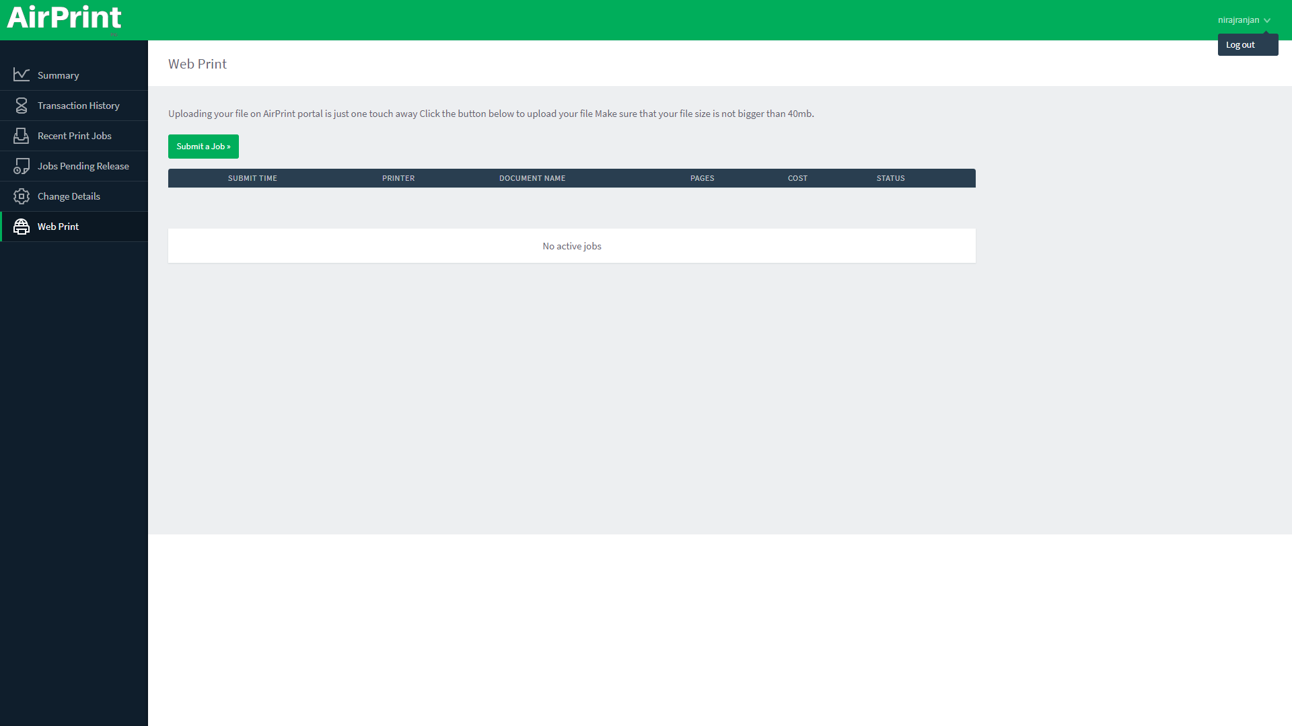

Slide 31
Airprint App

Slide 32


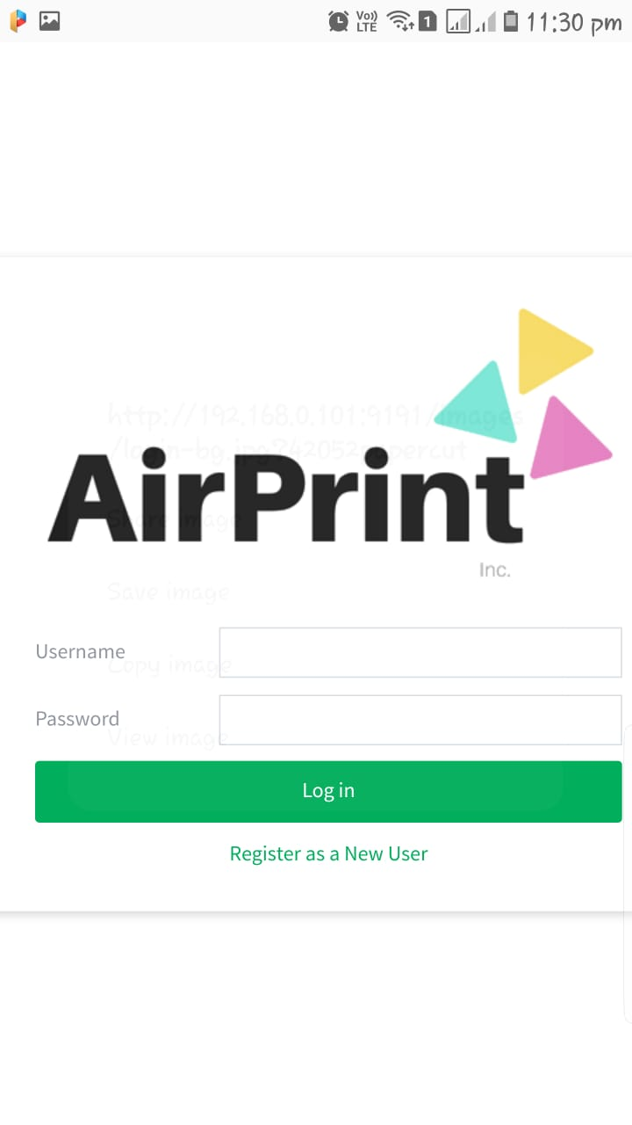

Slide 33
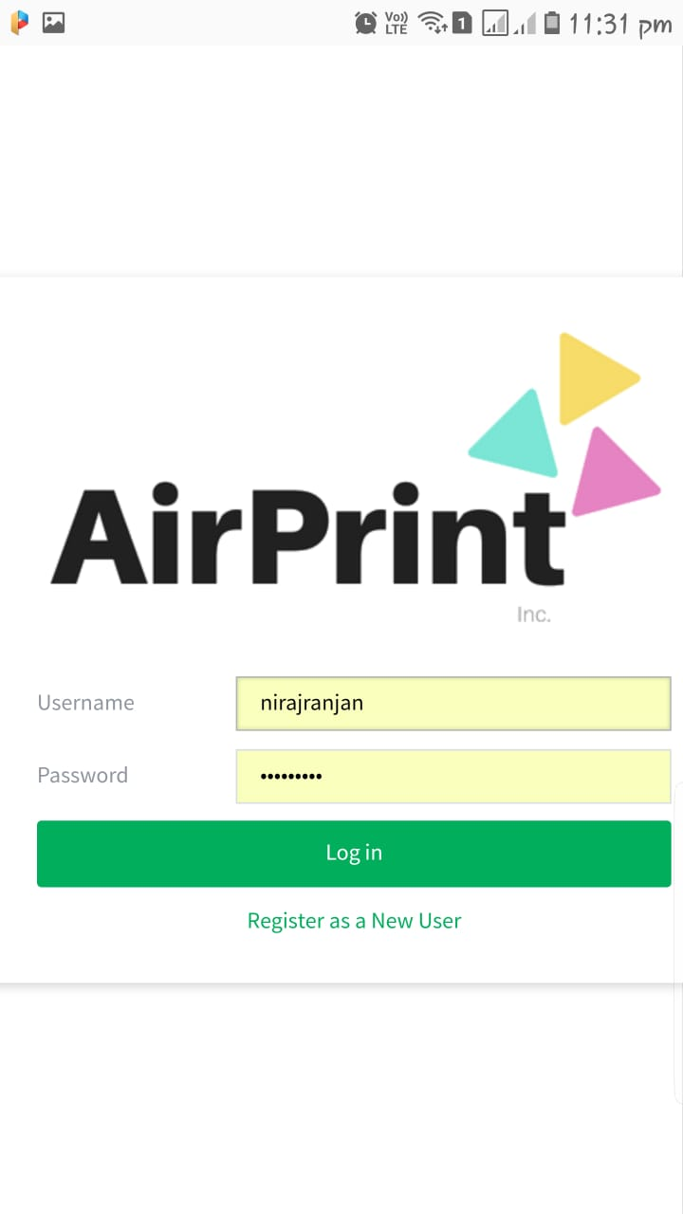
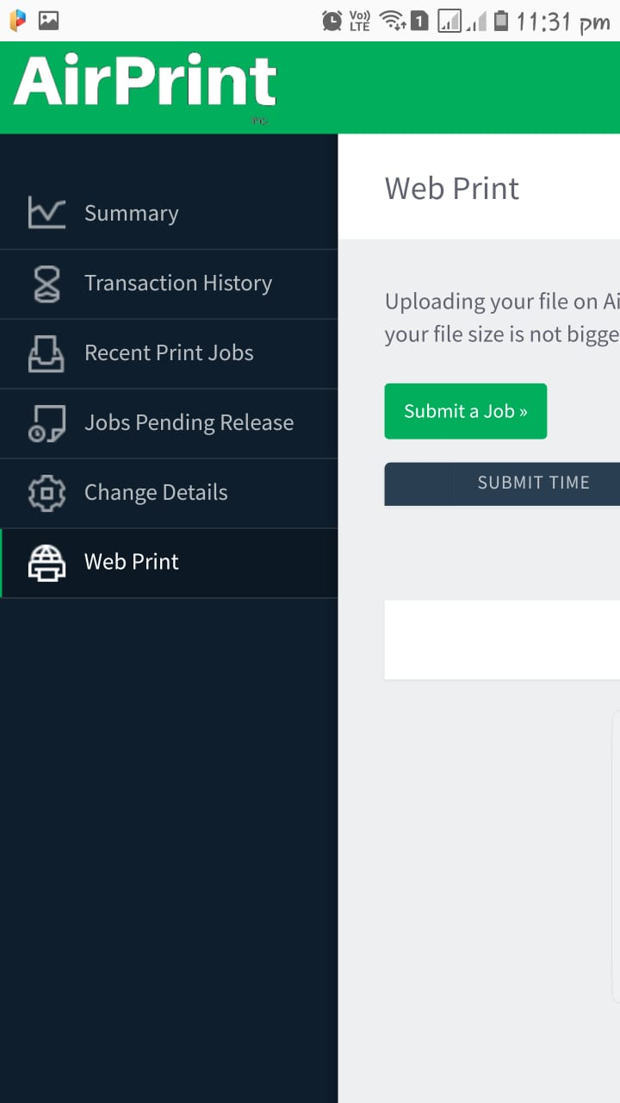

Slide 34
Email Bot (Airprint Bot)

Slide 35
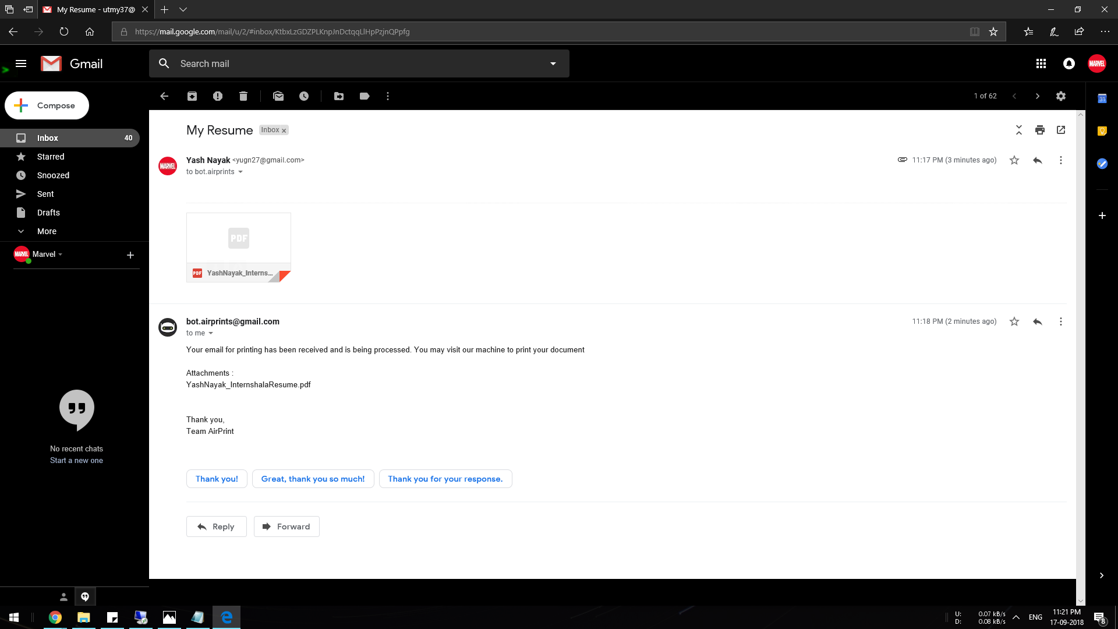

Slide 36
Telegram Bot (Airprint Bot)

Slide 37
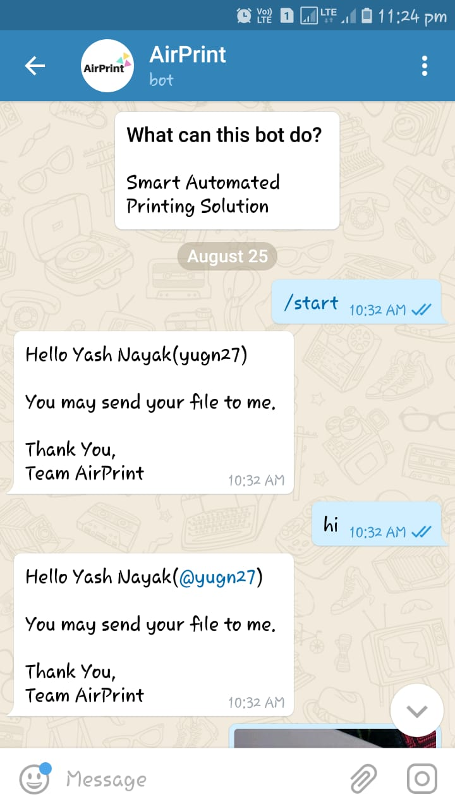
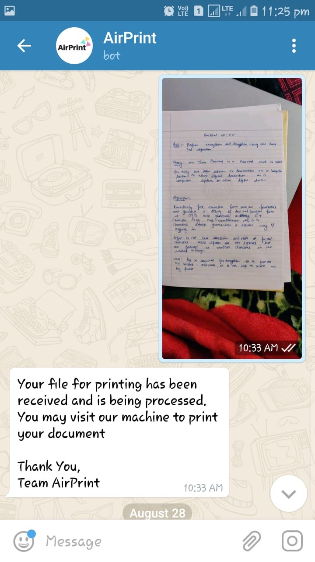

Slide 38
References
Ijisrt.com https://ijisrt.com/vprint-2-0
HP DeskJet 1112 Printer http://hp.com/Hewlett-Packard/4AA5_8342EEP1474430638935.pdf
Thingbits.net https://www.thingbits.net/products/raspberry-pi-3-model-b-1-4ghz-cortex-a53-with-1gb-ram
Official AirPrint website http://airprints.tk

Slide 39
Thank You

